Slide 1

Behaviour Curriculum 2024

Slide 2
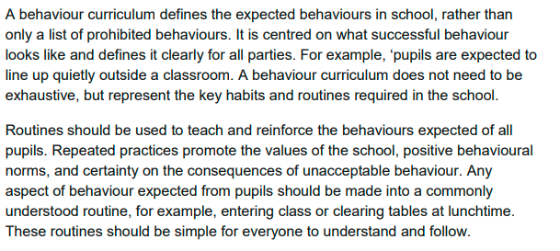
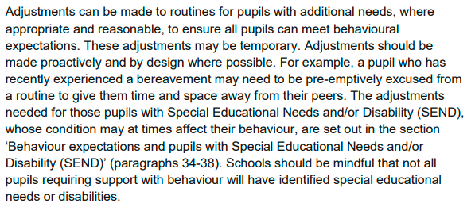







Our Behaviour curriculum Journey – What have we used to help us.
Department for Education advice for school’s on creating and implementing a behaviour curriculum.

Slide 3


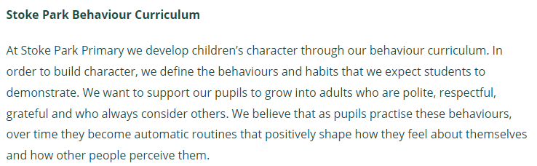
Recognition boards
Consistency
Restorative conversations
Building positive relationships

Slide 4

At St Martin’s, we will always

Slide 5
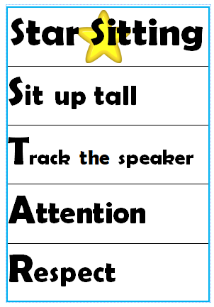
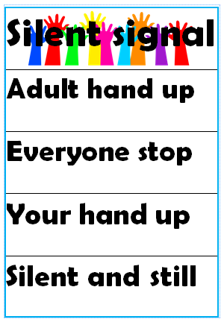
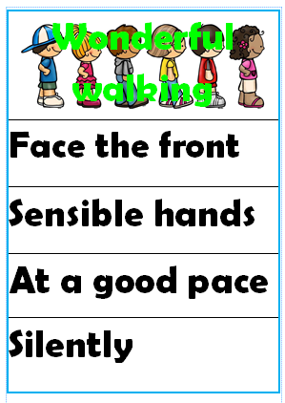
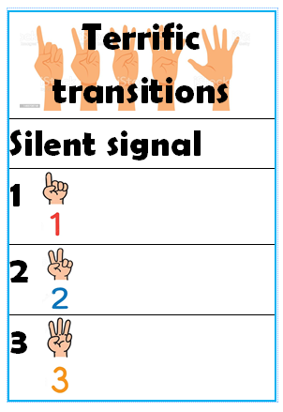
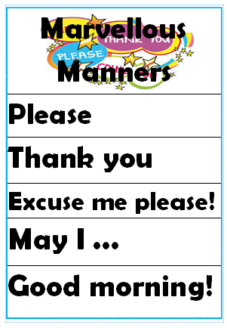
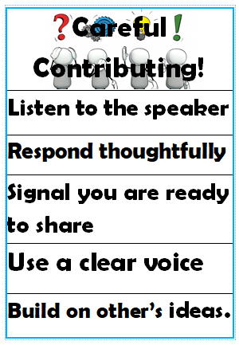



Focus
Celebrate!

Slide 6
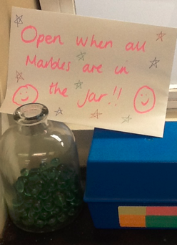
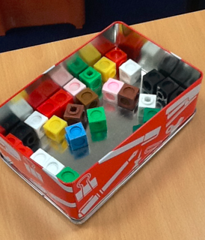
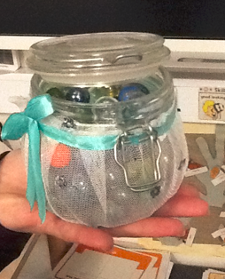
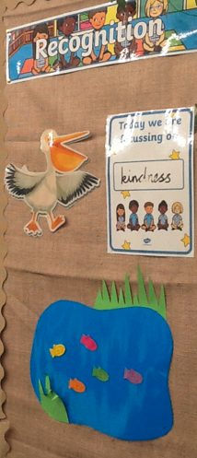
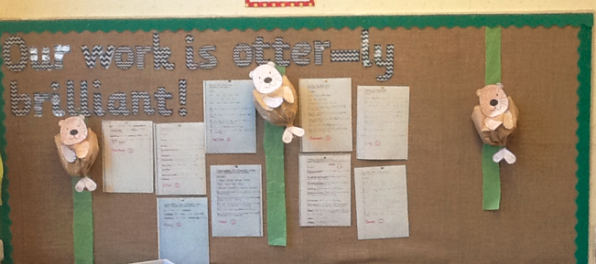
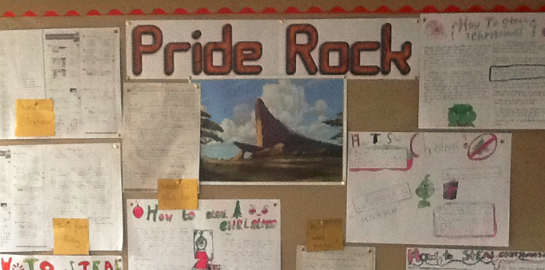

Slide 7
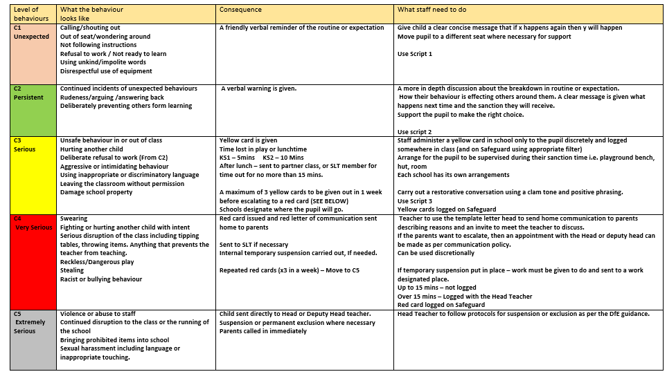

Slide 8
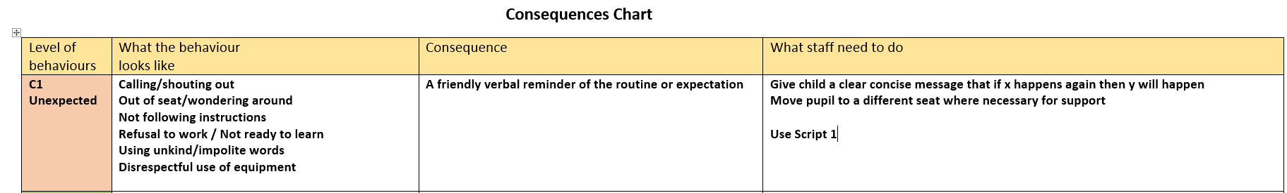
C1 - Unexpected
Teachers can use their judgement and discretion when giving this consequence. It might be that some children need a couple of reminders before moving to C2

Slide 9
C2 - Persistent
The same applies to this stage and positive reinforcement so the children can make the right choice before moving to C3.

Slide 10
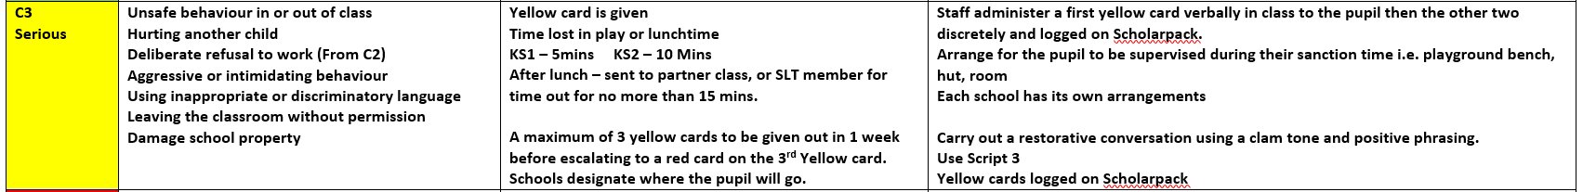
C3 - Serious
C3 begins the issuing of cards.
They have had all the warnings and reminders.

Slide 11
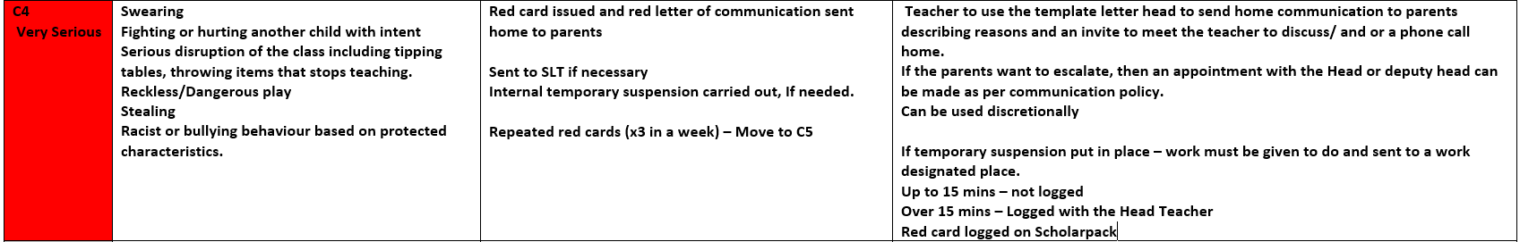
C4 – Very serious
A red letter can be sent to parents based on the teacher’s judgement.
The actual red card issued may be enough deterrent for the pupil.
The discussion about a red card will be a phone call – not on the playground.
If a red card is received on a Friday afternoon, then the consequence will be carried over to the Monday of the next week and explained to both pupil and parent.

Slide 12
C5 – Extremely Serious
Incidents can move straight to C4 or C5 based on the severity of the action.

Slide 13
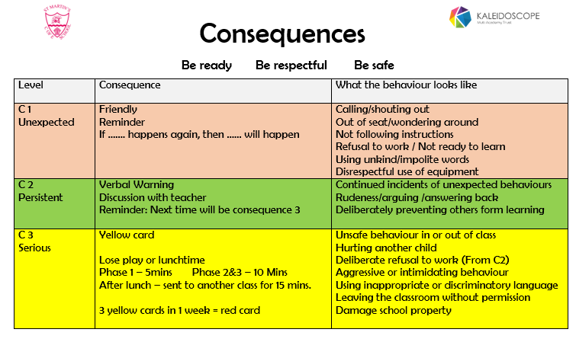

Slide 14
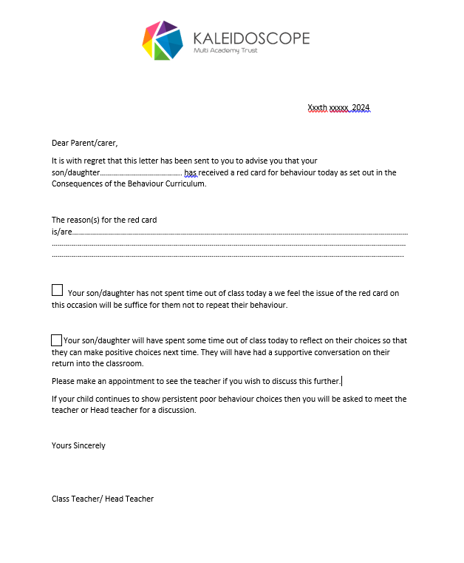
Red Card Letter to parents

Slide 15
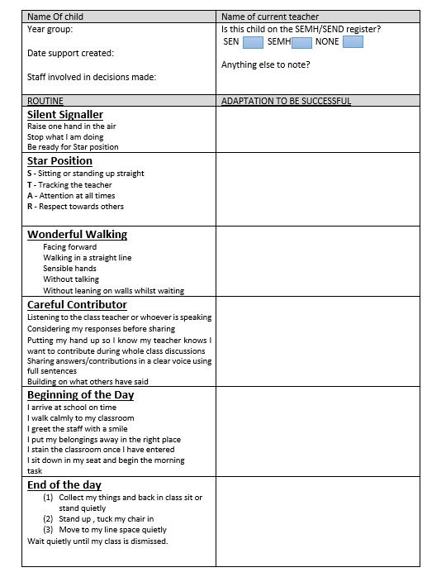
Success Plan Sheet

Slide 16
Thank you for joining us!
☺

